Slide 1
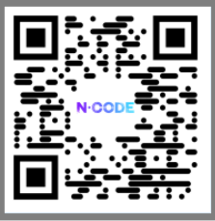
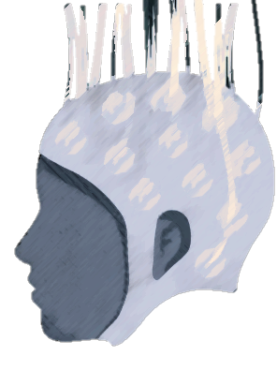


Non-invasive BCI for remote rehab and training of motor skills​
Katja Kornysheva, UoB (PI)
Anna Sadnicka, UCL
Shahzad, UoB
Amin Rahmat, UoB
Fei He, Coventry
Drummond Masterton, Falmouth
Katja Kornysheva & Martin Geiger
Project start: December 2023
N-Code Expo: 10-11 June 2024
Notes:
Thank you for organising this conference! Today Martin and I will update on an N-Code-fundedl Seed project that started in Dec 2024 on Non-invasive BCI for remote rehab and training of motor skills

Slide 2
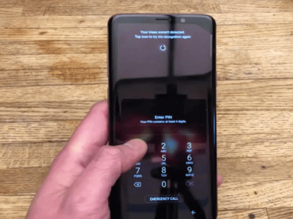
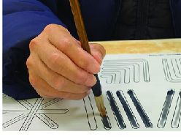
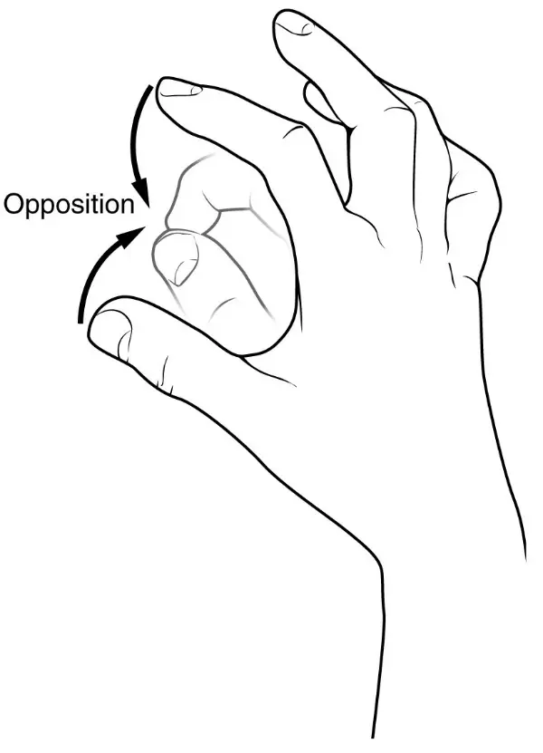

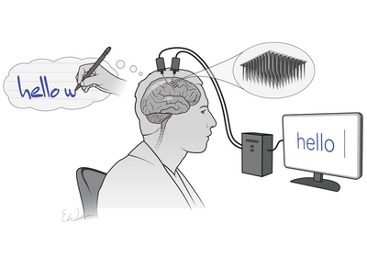
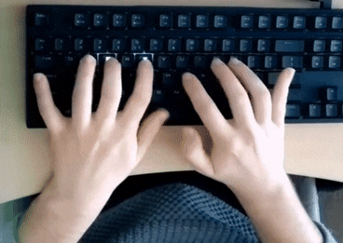
The challenge
Skilled actions
Breakdown
Rehabilitation
Stroke, Parkinson’s Disease, Dyspraxia
Clinical deficits in
movement initiation, execution and sequencing
Occupational therapy
Brain/spinal surgery
Notes:
Skilled actions such as unlocking your phone with a code, handwriting, typing on a keyboard, are something we largely take for granted.
However, many conditions, from strokes to learning disabilities, can greatly impair an individual’s ability to perform these actions. This can limit someone's independence and make daily tasks frustrating, with very high costs for patients and society.
Right now, there are ways to help people regain these skills, like occupational therapy. But these options can be expensive and hard to find. We also have options of invasive brain-computer interface technology that required surgery but it can be risky and often reserved for very serious cases.

Slide 3
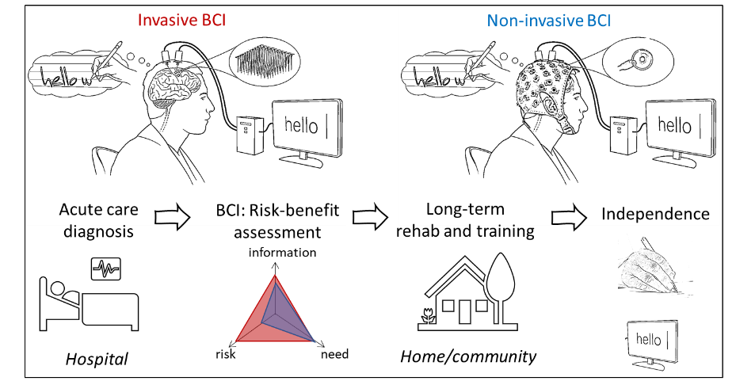
The vision for non-invasive BCI
Need for faster, safer and more accessible neuro-rehab
Notes:
Patients with milder forms of stroke, early Parkinson’s and those with neurodevelopmental conditions are largely excluded from these invasive BCI-based applications due to a poor risk-benefit ratio of invasive neurotech.
At the same time there is an acute need of rehab outside the hospital environment, due to the severe economic pressures on the NHS. This is why we need to built safer and more accessible neuro-rehab to help people relearn skilled actions and regain their independence faster.

Slide 4
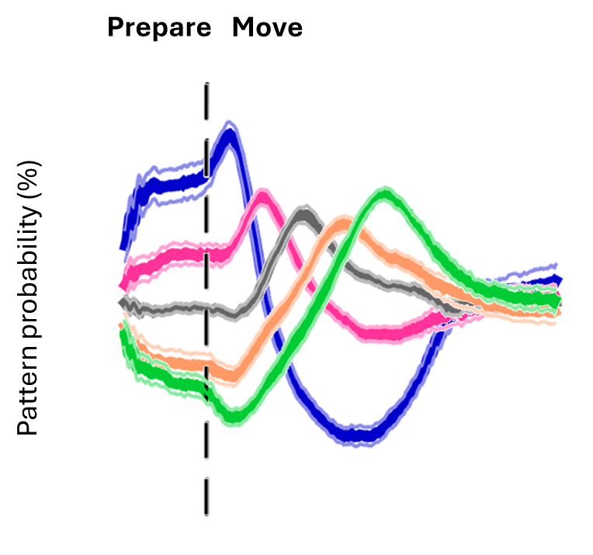
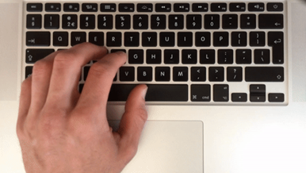

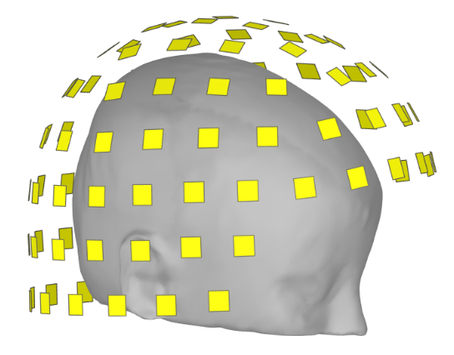
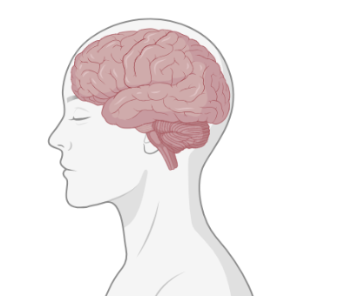
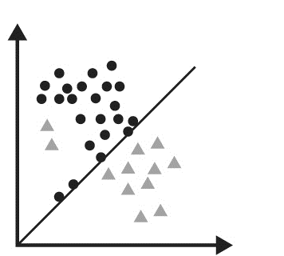
Movement planning as a target for BCI
Kornysheva & Diedrichsen 2014, eLife
Kornysheva et al. 2019, Neuron
Yewbrey et al. 2023, J Neurosci
Yewbrey & Kornysheva 2024, bioRxiv
Prepare
Move
Prepare
Move
Neural decoding:
Machine learning
‘G-R-E-A-T-E-R’
Decoding movements before they begin
Notes:
Traditionally, in rehab and in the lab we guide patients through movements repeatedly, even when it's frustrating and patients struggle to perform them. But what if we could intervene even before someone starts moving?
It turns out that the brain isn't just sitting idle when you're planning a movement. Those brain patterns are like an instructive code, directly linked to how well you actually perform the movement.
In my lab we have used non-invasive recordings of brain activity and machine learning to decode action plans before any movement takes place.

Slide 5
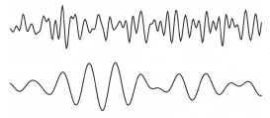
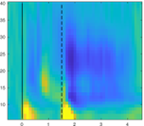
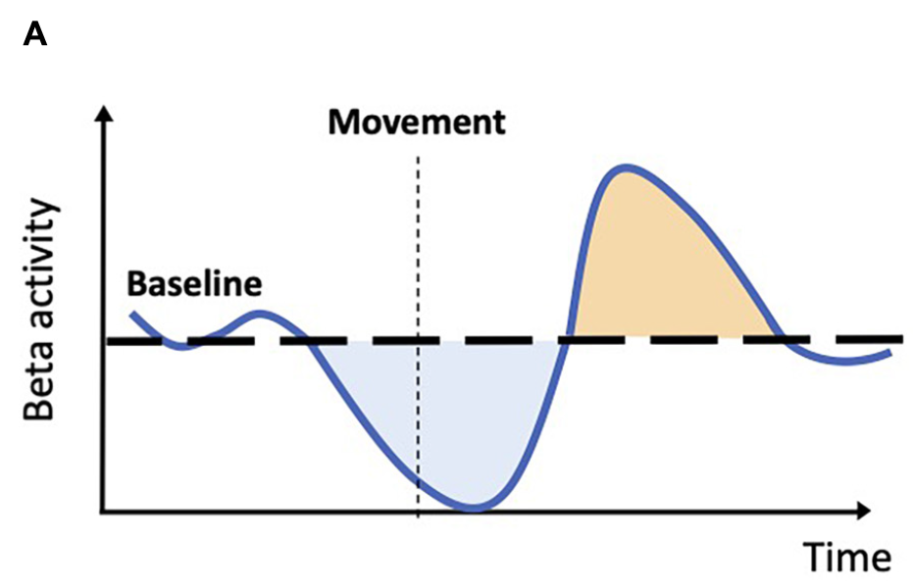
Movement planning as a target for BCI
Barone & Rossitter 2021
Neural oscillations:
Prepare
Move
Prepare
Move
β: 13-30Hz
α/µ: 8-12 Hz
Regulating neural oscillations before movement starts.
‘G-R-E-A-T-E-R’
Notes:
Moreover, neural dynamics that we can observe in specific frequency bands of neural activity recorded on the scalp such as beta and alpha oscillations seems to be related to the state of excitation and inhibition in an individual’s brain and are reported to be disrupted in movement disorders. Both the decoded organisation and these neural oscillation during movement planning, BEFORE movement starts are thus a potential target for non-invasive BCI applications.

Slide 6







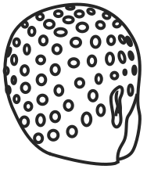

Movement planning as a target for BCI
Dr Katja Kornysheva, neuroscientist (University of Birmingham)
Dr Anna Sadnicka, neurologist (National Hospital for Neurology and Neurosurgery, Gatsby Computational Neuroscience Unit, University College London)
Dr Atif Shahzad, engineer (University of Birmingham)
Dr Fei He, computer scientist (Coventry University)
Drummond Masterton, product designer (Falmouth University)
Dr Amin Rahmat, mathematician (University of Birmingham)
Seed Project start: Dec 2023
Martin Geiger (RA):
Analysis of existing EEG datasets (typing sequences from memory)
Brain-computer-interface neurofeedback prototype development
Notes:
At one of the Ncode study groups, we came together as part of the sandpit around this challenge, and formed a group spanning neuroscientists….to start a 1 year Seed project.
And today, half a year after the project start, Martin Geiger who is an RA on this project will report some of the progress, specifically our first findings based on existing EEG recordings and the development of a brain-computer-interface prototype.

Slide 7
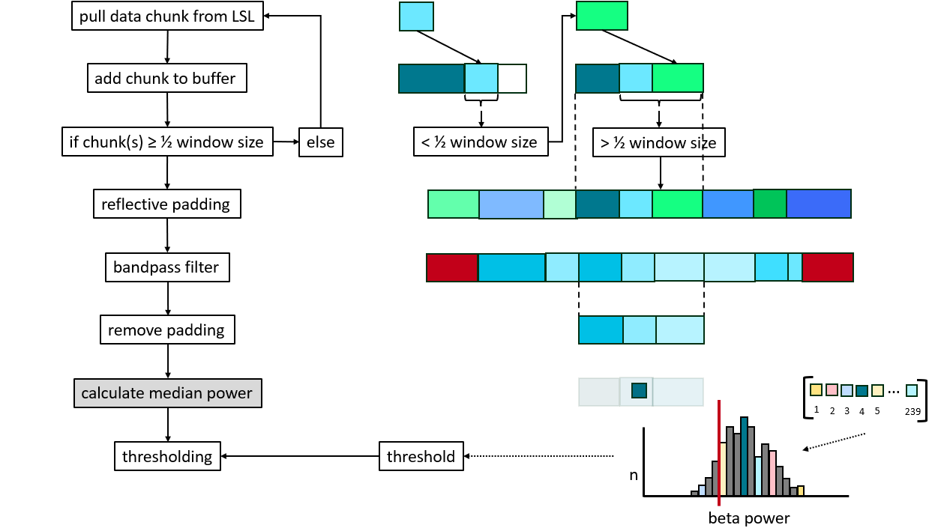
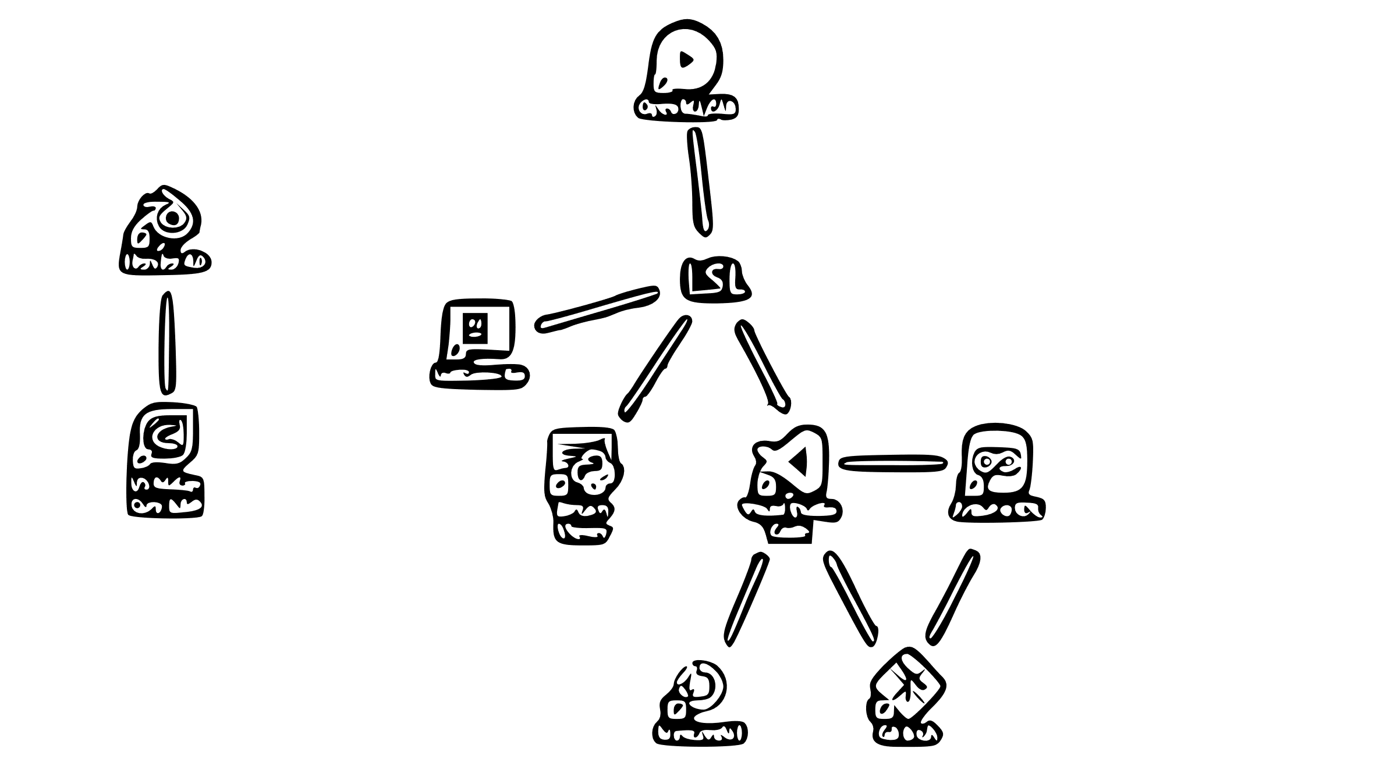
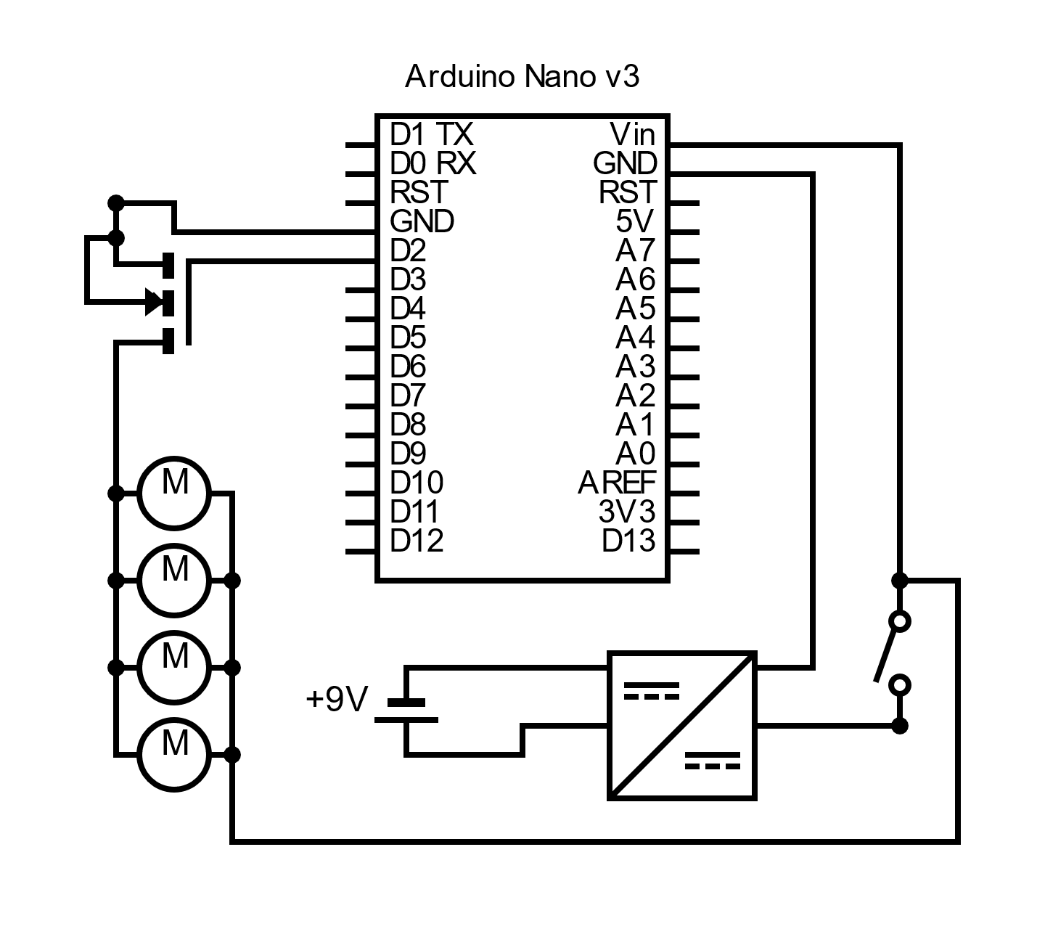
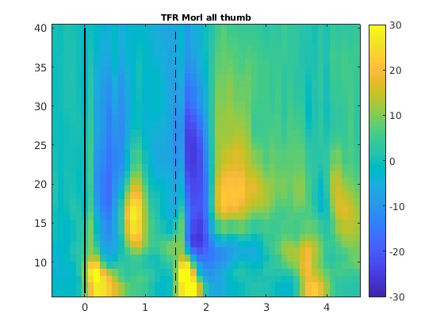
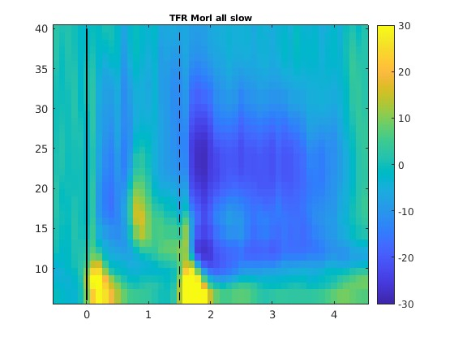
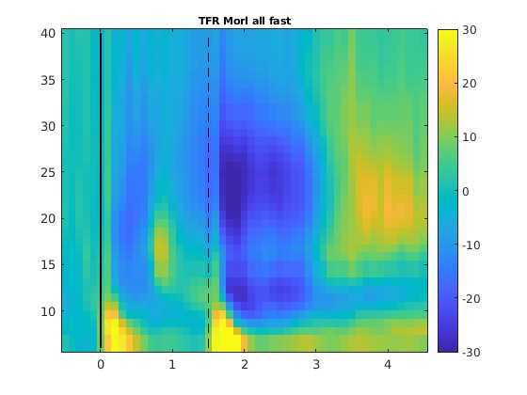
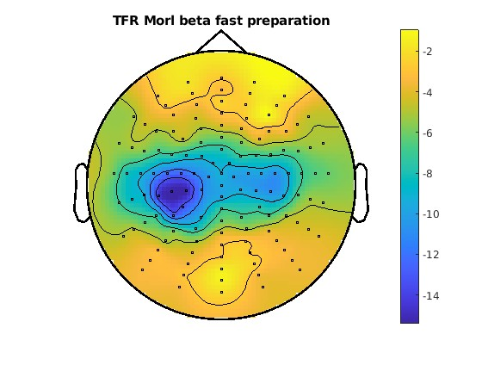


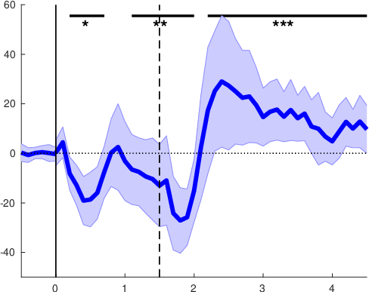
rtNFB
software
haptic feedback
cqEEG
LMM | RT ~ 1 + power + (1|subject)
power [s] | 0 – 1.5 | 0 – 0.3 | 0.4 - 0.7 | 0.8 – 1.1 | 1.2 -1.5
mu | 0.354 | 0.203 | 0.370 | 0.013 | 0.761
lowB | 0.066 | 0.588 | 0.007 | 0.021 | 0.992
highB | 0.742 | 0.538 | 0.854 | 0.083 | 0.861
beta | 0.246 | 0.501 | 0.150 | 0.022 | 0.984

Slide 8
software
rtNFB
cqEEG
haptic feedback
LMM | RT ~ 1 + power + (1|subject)
power [s] | 0 – 1.5 | 0 – 0.3 | 0.4 - 0.7 | 0.8 – 1.1 | 1.2 -1.5
mu | 0.354 | 0.203 | 0.370 | 0.013 | 0.761
lowB | 0.066 | 0.588 | 0.007 | 0.021 | 0.992
highB | 0.742 | 0.538 | 0.854 | 0.083 | 0.861
beta | 0.246 | 0.501 | 0.150 | 0.022 | 0.984

Slide 9
software
rtNFB
cqEEG
haptic feedback
LMM | RT ~ 1 + power + (1|subject)
power [s] | 0 – 1.5 | 0 – 0.3 | 0.4 - 0.7 | 0.8 – 1.1 | 1.2 -1.5
mu | 0.354 | 0.203 | 0.370 | 0.013 | 0.761
lowB | 0.066 | 0.588 | 0.007 | 0.021 | 0.992
highB | 0.742 | 0.538 | 0.854 | 0.083 | 0.861
beta | 0.246 | 0.501 | 0.150 | 0.022 | 0.984

Slide 10
TFRs
rtNFB
software
Fast
cqEEG
Slow
Thumb
Frequency [Hz]
LMM | RT ~ 1 + power + (1|subject)
power [s] | 0 – 1.5 | 0 – 0.3 | 0.4 - 0.7 | 0.8 – 1.1 | 1.2 -1.5
mu | 0.354 | 0.203 | 0.370 | 0.013 | 0.761
lowB | 0.066 | 0.588 | 0.007 | 0.021 | 0.992
highB | 0.742 | 0.538 | 0.854 | 0.083 | 0.861
beta | 0.246 | 0.501 | 0.150 | 0.022 | 0.984
Time [s]
haptic feedback

Slide 11
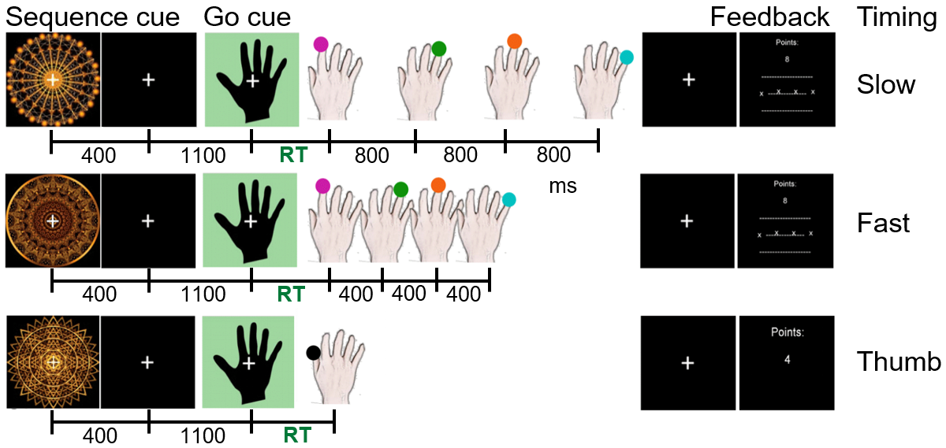
Task Finger sequence production from memory
Behavioural measures: reaction time (RT) + timing accuracy
Notes:
18 healthy participants participated in a finger sequence production task:
Learned to produce a sequence of 4 finger presses with different timings in the slow and fast conditions - or single press (control)
On each trial:
sequence cue
-> 1.5s to prepare the finger sequence
1st press should be as quick as possible, which is the RT that I will refer to later
Slow condition: 800ms intervals between the key presses – fast condition: only 400ms
Feedback: RT + accuracy of their timing

Slide 12
Time-frequency representations (TFRs)
Slow
Fast
Thumb
Frequency [Hz]
Power [percent change]
Time [s]
ERD occurs during movement sequence preparation & production
Notes:
EEG data: offline analysis
Oscillatory activity over motor cortex – how it changes during trial:
Color: power
… and ERD is a decrease in power – so the blue parts
1) Duration of ERD during movement production is dependent on the condition – bcs in the slow condition the presses were spaced further apart than in the fast condition, and in the thumb condition it was just one quick finger movement
2) After the movement sequence we see a beta rebound – ie high power – except for slow condition (cut off at end of plot)
3) IMPORTANT: we see the same pattern during preparation of the movement sequence: first ERD then rebound

Slide 13
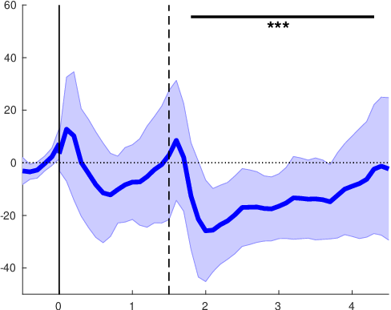
Cluster-based permutation test
Thumb
Fast
Slow
During what times in a trial can we see significant deviations from baseline?
Power [percent change]
mu
Time [s]
ERD during production, but not preparation
Notes:
Test statistically: During what times in a trial the neuronal activity significantly deviates from baseline?
Mu:
- preparation: fluctuates around 0
- production: cluster of very significant ERD

Slide 14
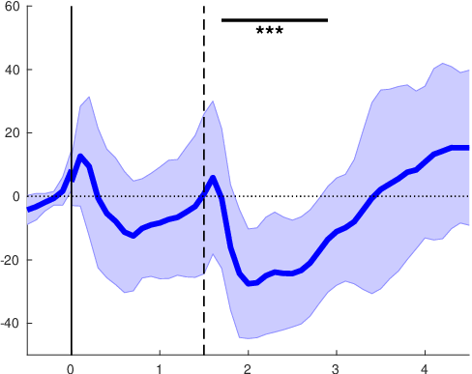
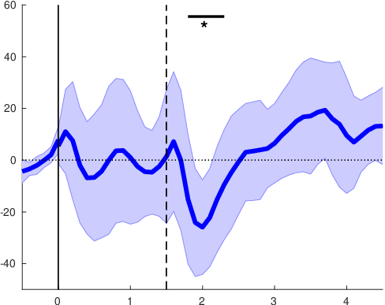
Cluster-based permutation test
Slow
Fast
Thumb
Power [percent change]
mu
Time [s]
Notes:
In the other two conditions we see the same thing for mu:
Significant clusters during production
Again: they get shorter depending on the condition

Slide 15
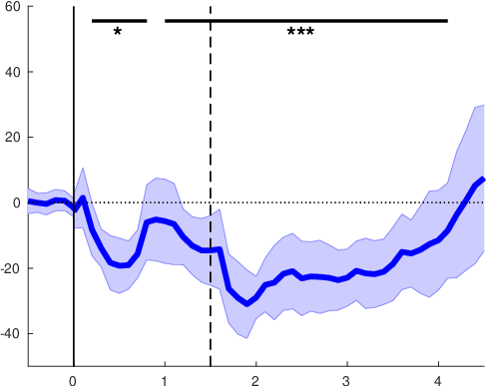
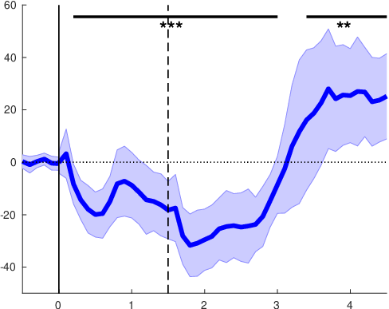
Cluster-based permutation test
Slow
Fast
Thumb
mu
Power [percent change]
beta
Time [s]
ERD during preparation only in beta
Notes:
IMPORTANT difference in beta:
ERD – as we saw before- is also observable during the preparation phase
And, similar to mu, also during production

Slide 16
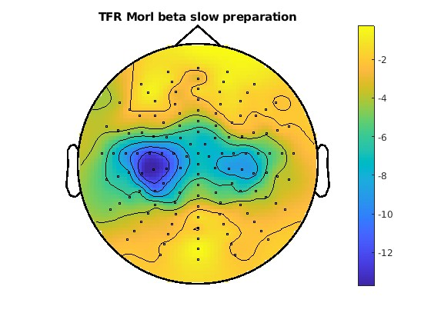
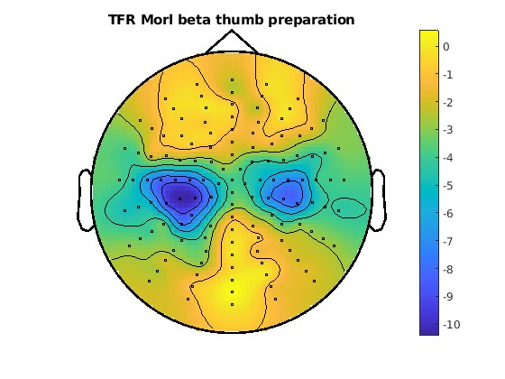
Topographies beta (13-30 Hz) - planning
Slow
Fast
Thumb
Beta ERD occurs over contralateral motor cortex
Notes:
…where in the brain the beta ERD occurs?
-> Contralateral motor cortex
… in all 3 conditions – very similar

Slide 17
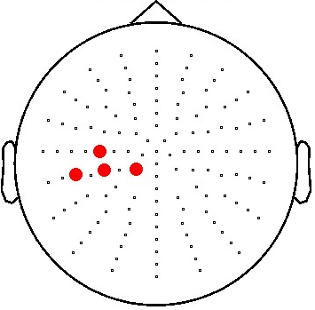
Linear mixed models (LMMs)
Predictors of behaviour:
- Which frequency band …
- at what time during preparation …
- predicts RT and sequence timing?
p-values
LMM | RT ~ 1 + power + (1|subject)
power [s] | 0 – 1.5 | 0 – 0.3 | 0.4 - 0.7 | 0.8 – 1.1 | 1.2 -1.5
mu | 0.354 | 0.203 | 0.370 | 0.013 | 0.761
lowBeta | 0.066 | 0.588 | 0.007 | 0.021 | 0.992
highBeta | 0.742 | 0.538 | 0.854 | 0.083 | 0.861
beta | 0.246 | 0.501 | 0.150 | 0.022 | 0.984
timingAccuracy ~ 1 + power + (1|subject)
0 – 1.5 | 0 – 0.3 | 0.4 - 0.7 | 0.8 – 1.1 | 1.2 -1.5
0.121 | 0.256 | 0.647 | 0.160 | 0.430
0.010 | 0.248 | 0.131 | 0.037 | 0.160
<.001 | 0.061 | 0.040 | 0.007 | 0.027
<.001 | 0.082 | 0.030 | 0.004 | 0.029
Beta power between 0.4 - 1.1s is most predictive of behaviour
Notes:
LMMs: Which frequency band … at what time during preparation … predicts RT and sequence timing?
We modelled RT and timingAccuracy with an intercept, power as fixed effect, and subjects as random effect.
Mu and lowBeta predict RT in the 400-1100ms interval of the preparation period
lowBeta seems to drive this significance if we look at the whole beta band
timingAccuracy is only predicted by beta, not mu, in the same time intervals.

Slide 18
Linear mixed models (LMMs)
Predictors of behaviour:
- Which frequency band …
- at what time during preparation …
- predicts RT and sequence timing?
p-values
LMM | RT ~ 1 + power + (1|subject)
power [s] | 0 – 1.5 | 0 – 0.3 | 0.4 - 0.7 | 0.8 – 1.1 | 1.2 -1.5
mu | 0.354 | 0.203 | 0.370 | 0.013 | 0.761
lowBeta | 0.066 | 0.588 | 0.007 | 0.021 | 0.992
highBeta | 0.742 | 0.538 | 0.854 | 0.083 | 0.861
beta | 0.246 | 0.501 | 0.150 | 0.022 | 0.984
maxERD | 0.311 | 0.047 | 0.797 | 0.594 | 0.235
timingAccuracy ~ 1 + power + (1|subject)
0 – 1.5 | 0 – 0.3 | 0.4 - 0.7 | 0.8 – 1.1 | 1.2 -1.5
0.121 | 0.256 | 0.647 | 0.160 | 0.430
0.010 | 0.248 | 0.131 | 0.037 | 0.160
<.001 | 0.061 | 0.040 | 0.007 | 0.027
<.001 | 0.082 | 0.030 | 0.004 | 0.029
0.027 | 0.129 | 0.137 | 0.271 | 0.239
High inter-subject variability in narrow frequency band that shows maximal ERD
neg corr
pos corr
Notes:
What we didn’t expect is, that these correlations were negative.
So, we ran further analyses, and due to the fact, that there’s a lot of inter-subject variability, we constricted the frequencies we looked at to a 5Hz band centered on the maximal ERD of each subject.
This approach has also been used in very similar studies.
… and resulted in the expected positive correlation between power and RT.

Slide 19
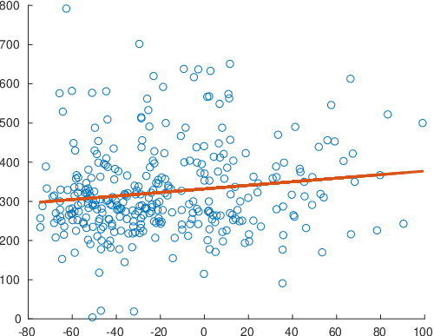
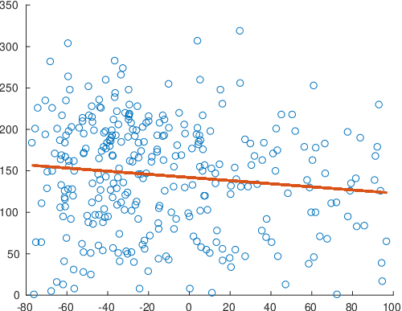
Inter-subject variability
Subject 1
Subject 3
p = 0.009
p = 0.033
RT [ms]
Power [relative change]
Different subjects show reversed relationships between power and RT
Notes:
We did some further analyses to look at individual subjects, and it really surprised us that the relation between behaviour and power can be reversed between subjects.
E.g. for subject 4, low power predicts low RTs, while for subject 6, high power predicts fast RTs.
Going forward, and thinking of our implementation of the BCI, we think that we need to first run a short RT test to determine this association for each participant and then feedback accordingly.

Slide 20
rtNFB
software
cqEEG
LMM | RT ~ 1 + power + (1|subject)
Power [ms] | 0 - 1500 | 0 - 300 | 400 -700 | 800 -1100 | 1200 -1500
Mu |  | * [+]
lowBeta |  |  | **[-]
highBeta
Beta |  |  | ** [-]
haptic feedback

Slide 21
software
rtNFB
cqEEG
haptic feedback
LMM | RT ~ 1 + power + (1|subject)
power [s] | 0 – 1.5 | 0 – 0.3 | 0.4 - 0.7 | 0.8 – 1.1 | 1.2 -1.5
mu | 0.354 | 0.203 | 0.370 | 0.013 | 0.761
lowB | 0.066 | 0.588 | 0.007 | 0.021 | 0.992
highB | 0.742 | 0.538 | 0.854 | 0.083 | 0.861
beta | 0.246 | 0.501 | 0.150 | 0.022 | 0.984

Slide 22
software
rtNFB
cqEEG
haptic feedback
LMM | RT ~ 1 + power + (1|subject)
power [s] | 0 – 1.5 | 0 – 0.3 | 0.4 - 0.7 | 0.8 – 1.1 | 1.2 -1.5
mu | 0.354 | 0.203 | 0.370 | 0.013 | 0.761
lowB | 0.066 | 0.588 | 0.007 | 0.021 | 0.992
highB | 0.742 | 0.538 | 0.854 | 0.083 | 0.861
beta | 0.246 | 0.501 | 0.150 | 0.022 | 0.984

Slide 23
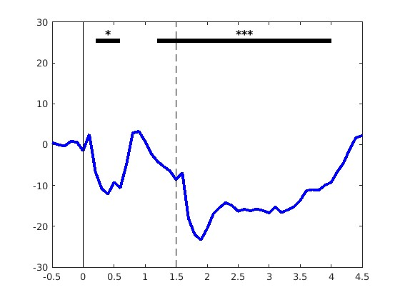
rtNFB
software
cqEEG
haptic feedback
cqEEG
LMM | RT ~ 1 + power + (1|subject)
Pow | all | 30 | 70 | 110 | 150
Mu |  | * |  |  | *
lowB | * |  | **
highB |  |  |  | **
Beta | * |  | **

Slide 25
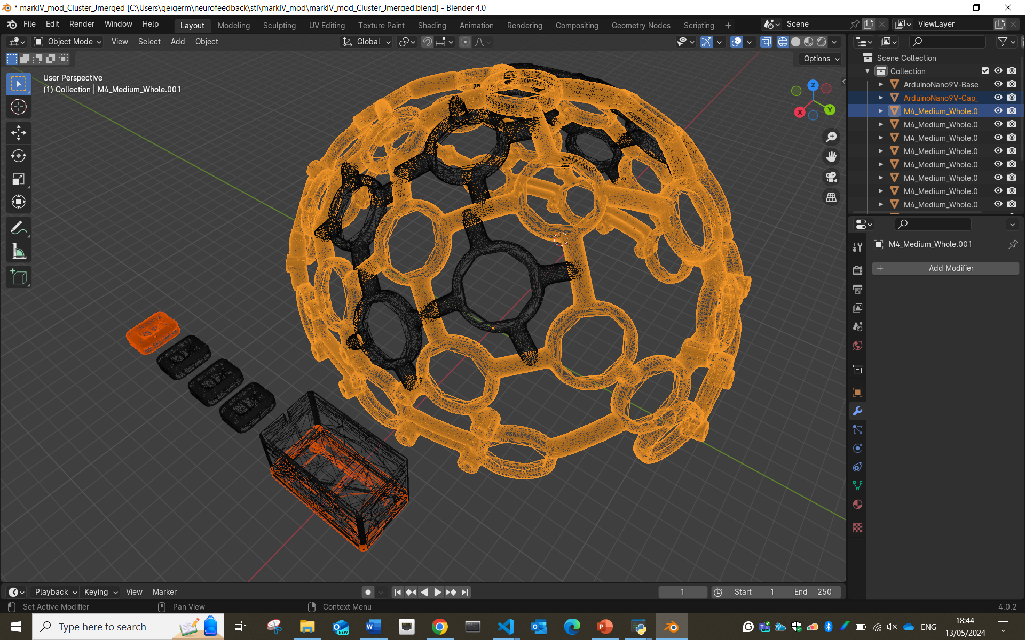
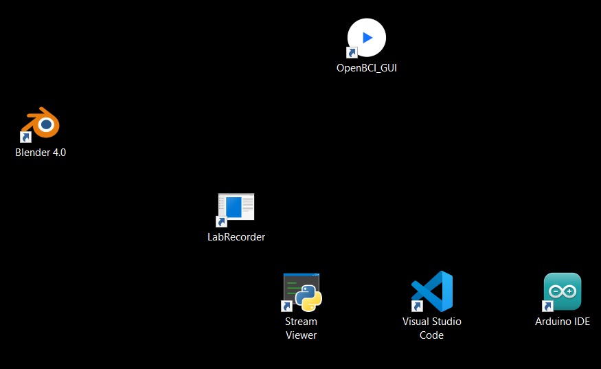
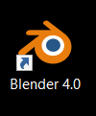
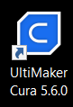
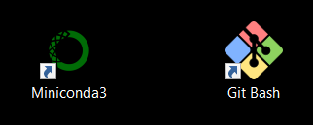
LSL

Slide 26
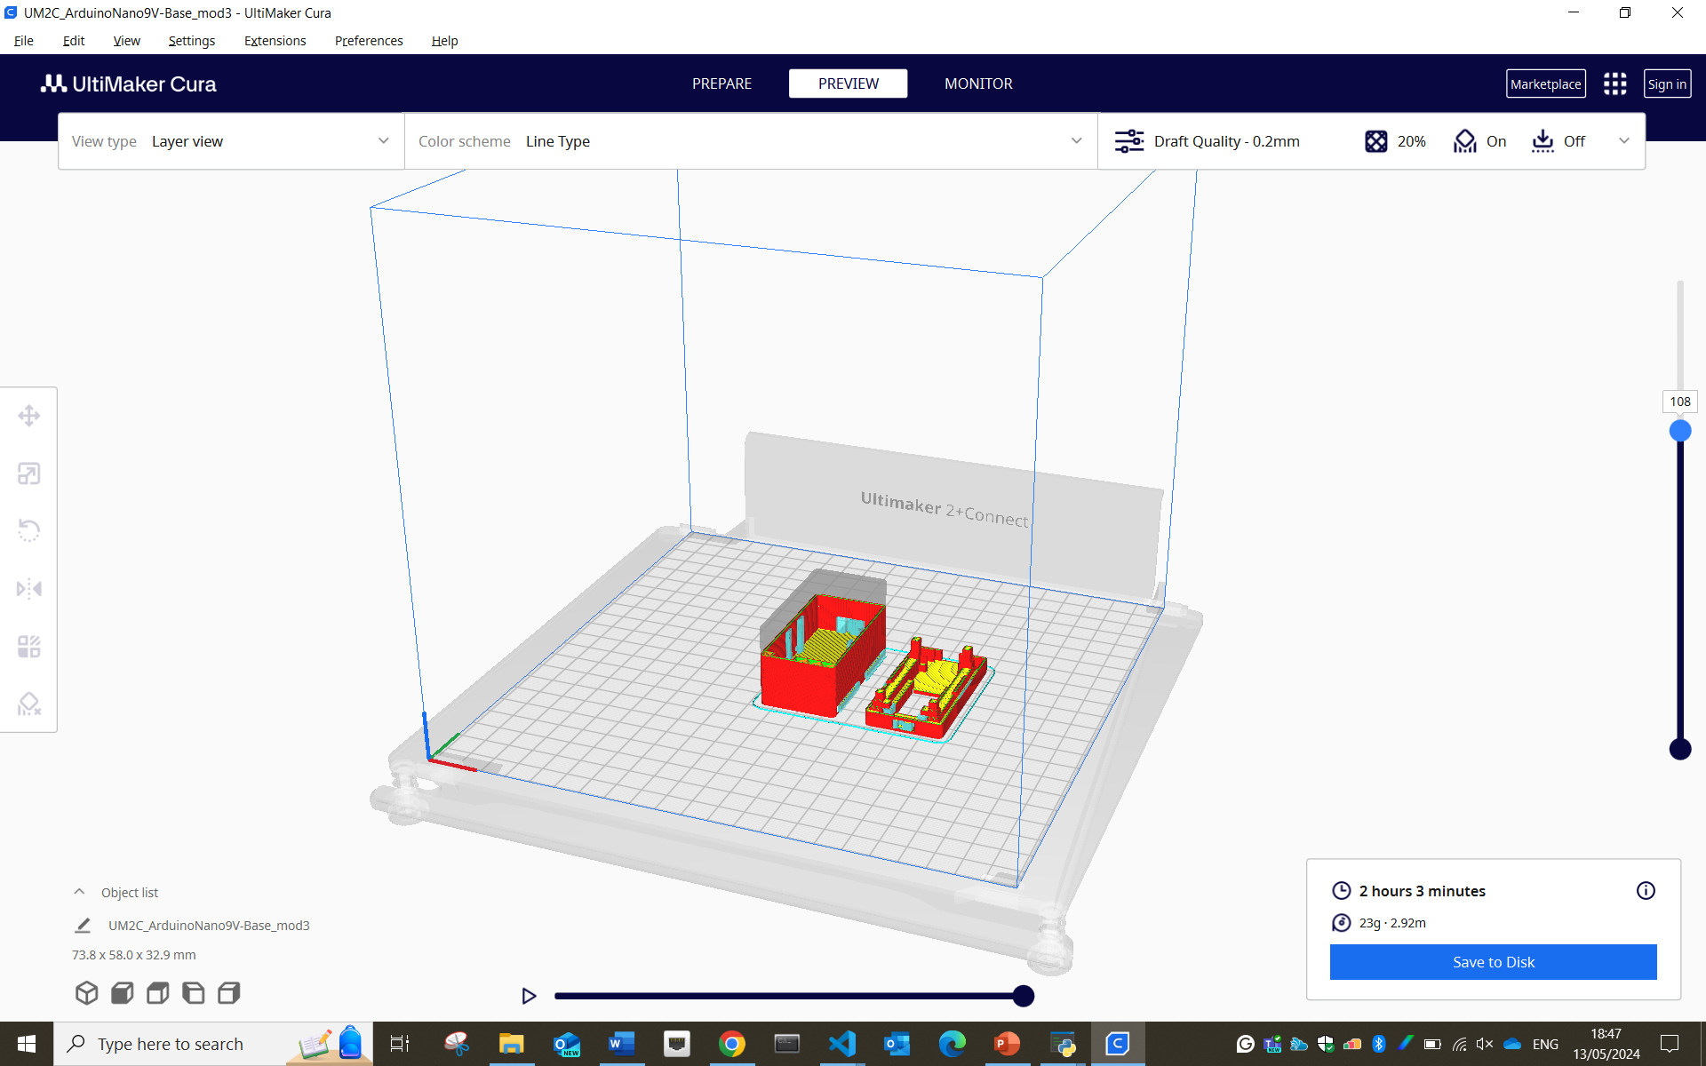
LSL

Slide 27
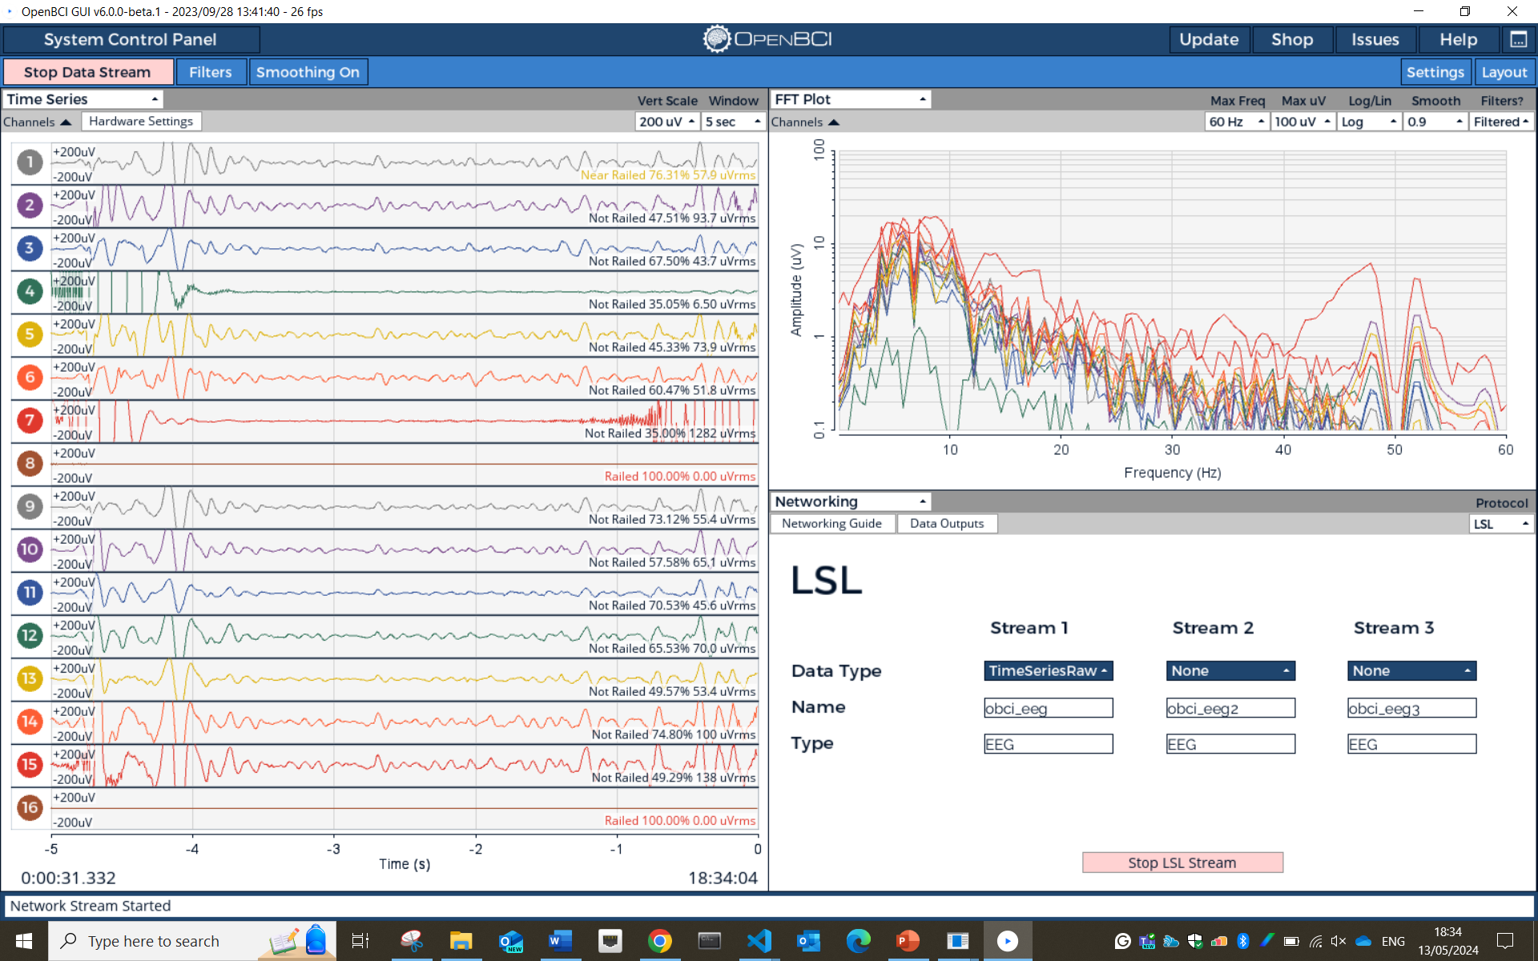
LSL

Slide 28
Lab Streaming Layer
stream, receive, synchronise, and record neural, physiological, and behavioural data streams acquired from diverse sensor hardware with millisecond-precision
LSL

Slide 29
EEG
EMG
IMUs
Lab Streaming Layer
stream, receive, synchronise, and record neural, physiological, and behavioural data streams acquired from diverse sensor hardware with millisecond-precision
LSL
…

Slide 30
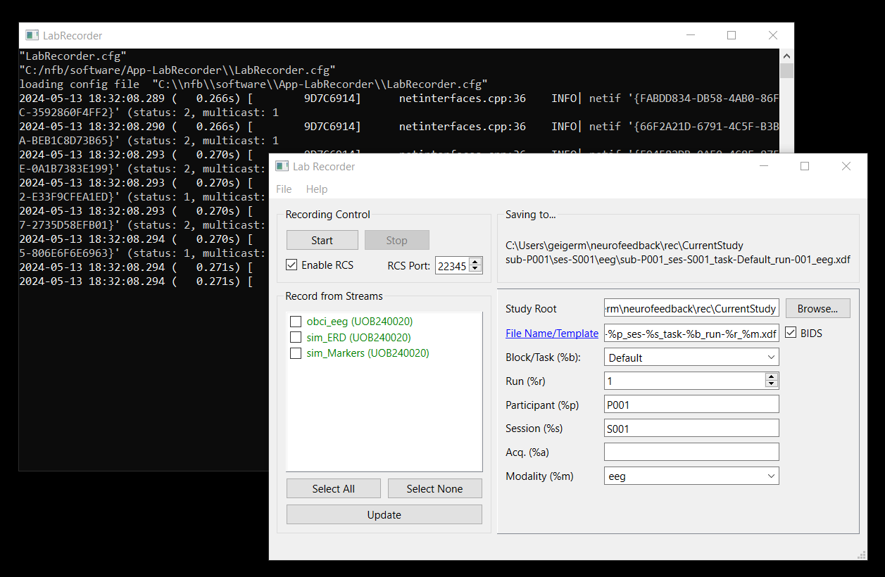
Lab Streaming Layer
stream, receive, synchronise, and record neural, physiological, and behavioural data streams acquired from diverse sensor hardware with millisecond-precision
EEG
EMG
LSL
IMUs
…

Slide 31
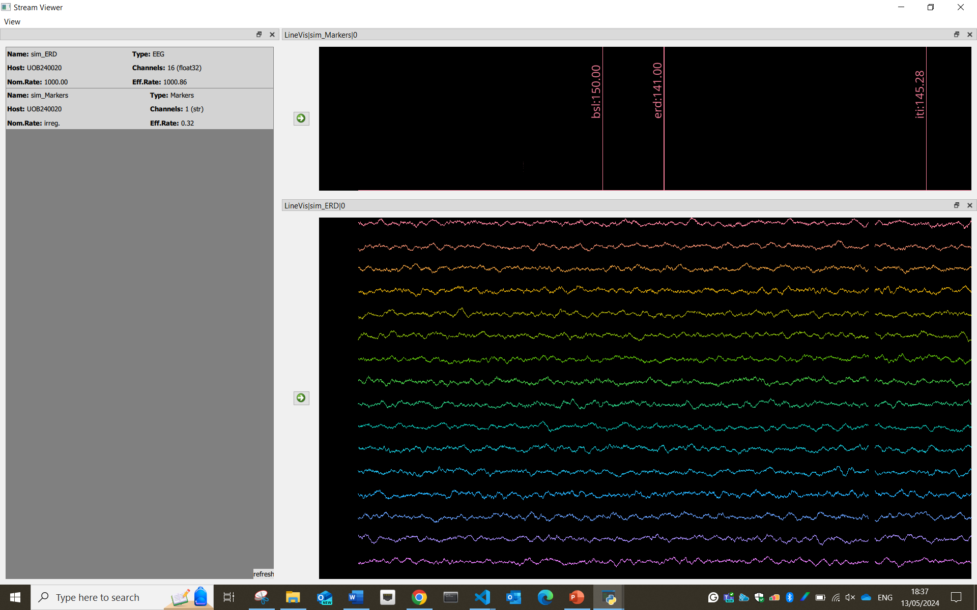
Lab Streaming Layer
stream, receive, synchronise, and record neural, physiological, and behavioural data streams acquired from diverse sensor hardware with millisecond-precision
LSL
EEG
EMG
IMUs
…

Slide 32
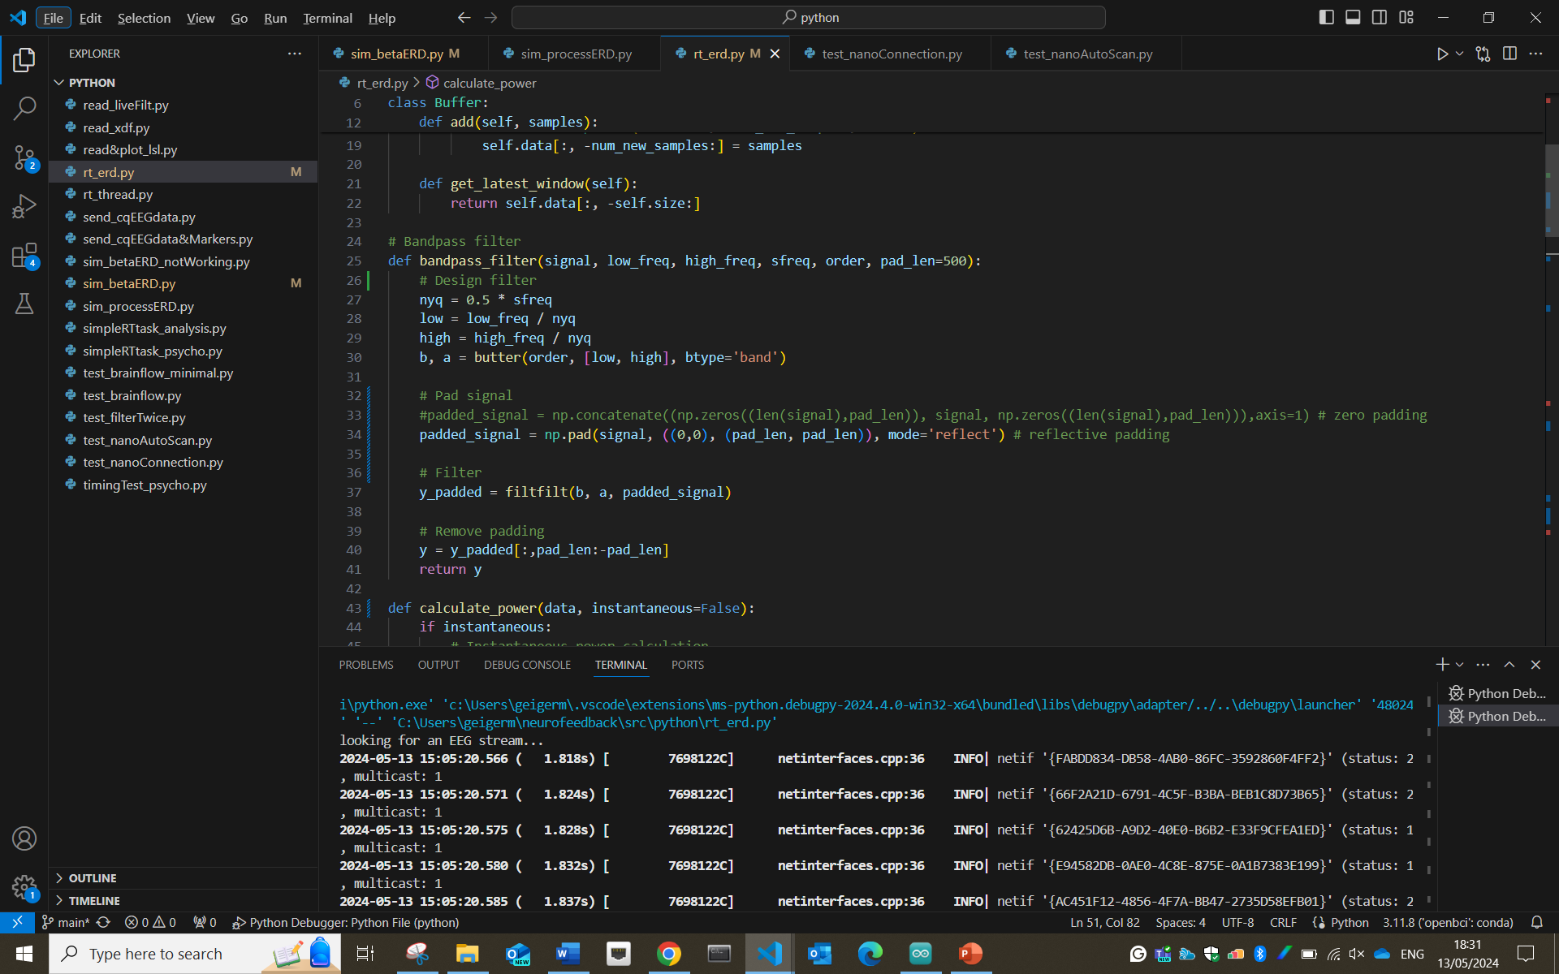
LSL

Slide 33
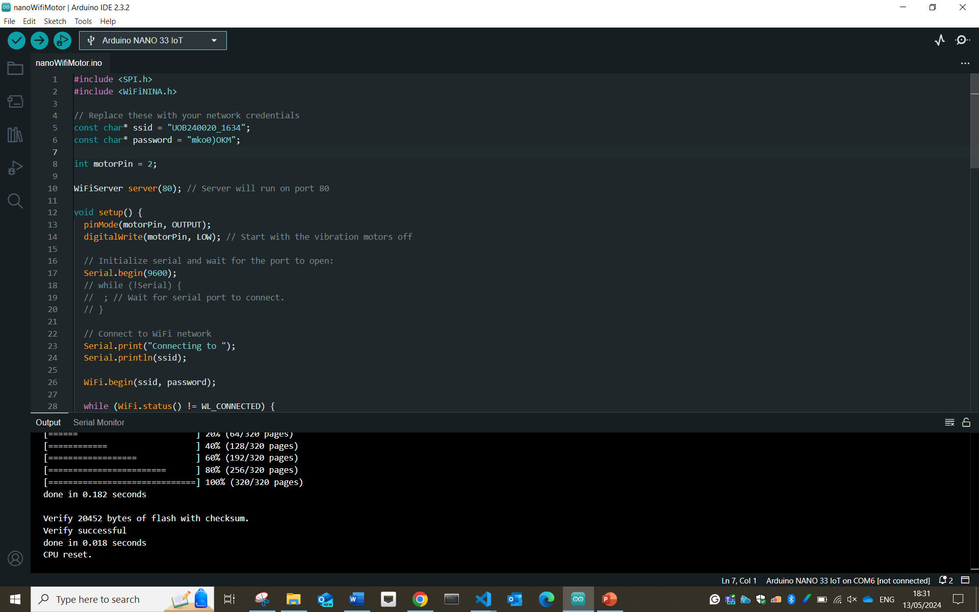
LSL

Slide 34
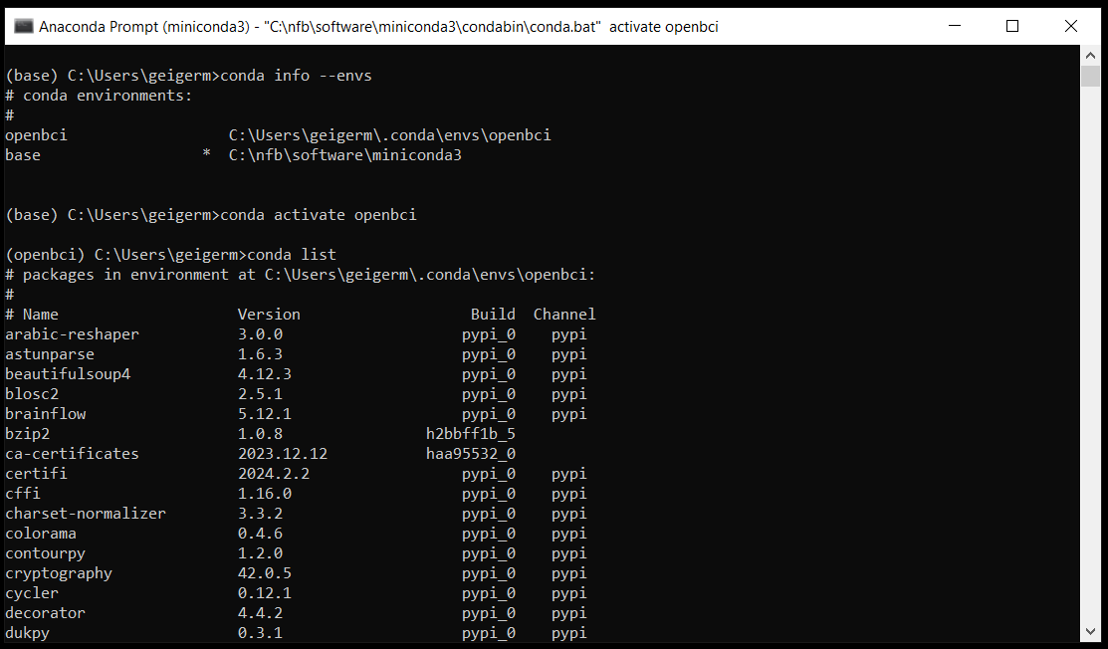
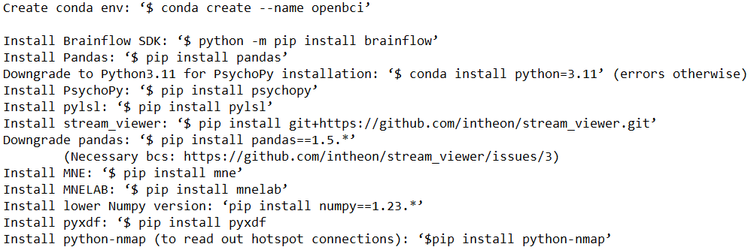
LSL

Slide 35

LSL

Slide 36
LSL

Slide 37
LSL

Slide 39

rtNFB
software
cqEEG
haptic feedback
LMM | RT ~ 1 + power + (1|subject)
power [s] | 0 – 1.5 | 0 – 0.3 | 0.4 - 0.7 | 0.8 – 1.1 | 1.2 -1.5
mu | 0.354 | 0.203 | 0.370 | 0.013 | 0.761
lowB | 0.066 | 0.588 | 0.007 | 0.021 | 0.992
highB | 0.742 | 0.538 | 0.854 | 0.083 | 0.861
beta | 0.246 | 0.501 | 0.150 | 0.022 | 0.984

Slide 40
software
rtNFB
cqEEG
haptic feedback
LMM | RT ~ 1 + power + (1|subject)
power [s] | 0 – 1.5 | 0 – 0.3 | 0.4 - 0.7 | 0.8 – 1.1 | 1.2 -1.5
mu | 0.354 | 0.203 | 0.370 | 0.013 | 0.761
lowB | 0.066 | 0.588 | 0.007 | 0.021 | 0.992
highB | 0.742 | 0.538 | 0.854 | 0.083 | 0.861
beta | 0.246 | 0.501 | 0.150 | 0.022 | 0.984

Slide 41
software
rtNFB
cqEEG
haptic feedback
LMM | RT ~ 1 + power + (1|subject)
power [s] | 0 – 1.5 | 0 – 0.3 | 0.4 - 0.7 | 0.8 – 1.1 | 1.2 -1.5
mu | 0.354 | 0.203 | 0.370 | 0.013 | 0.761
lowB | 0.066 | 0.588 | 0.007 | 0.021 | 0.992
highB | 0.742 | 0.538 | 0.854 | 0.083 | 0.861
beta | 0.246 | 0.501 | 0.150 | 0.022 | 0.984

Slide 42

software
250 ms
rtNFB
haptic feedback
cqEEG
LMM | RT ~ 1 + power + (1|subject)
power [s] | 0 – 1.5 | 0 – 0.3 | 0.4 - 0.7 | 0.8 – 1.1 | 1.2 -1.5
mu | 0.354 | 0.203 | 0.370 | 0.013 | 0.761
lowB | 0.066 | 0.588 | 0.007 | 0.021 | 0.992
highB | 0.742 | 0.538 | 0.854 | 0.083 | 0.861
beta | 0.246 | 0.501 | 0.150 | 0.022 | 0.984

Slide 43
250 ms
rtNFB

Slide 44
250 ms

Slide 45
250 ms

Slide 46
250 ms

Slide 47
250 ms

Slide 48
250 ms

Slide 49
pull data chunk from LSL

Slide 50
pull data chunk from LSL
add chunk to buffer

Slide 51
pull data chunk from LSL
add chunk to buffer
if chunk(s) ≥ ½ window size
else
< ½ window size

Slide 52
pull data chunk from LSL
add chunk to buffer
if chunk(s) ≥ ½ window size
else
< ½ window size

Slide 53
pull data chunk from LSL
add chunk to buffer
if chunk(s) ≥ ½ window size
else
< ½ window size

Slide 54
pull data chunk from LSL
add chunk to buffer
if chunk(s) ≥ ½ window size
else
< ½ window size

Slide 55
pull data chunk from LSL
add chunk to buffer
if chunk(s) ≥ ½ window size
else
< ½ window size
> ½ window size

Slide 56
pull data chunk from LSL
add chunk to buffer
if chunk(s) ≥ ½ window size
else
< ½ window size
> ½ window size
reflective padding
bandpass filter

Slide 57
pull data chunk from LSL
add chunk to buffer
if chunk(s) ≥ ½ window size
else
< ½ window size
> ½ window size
reflective padding
bandpass filter

Slide 58
pull data chunk from LSL
add chunk to buffer
if chunk(s) ≥ ½ window size
else
< ½ window size
> ½ window size
reflective padding
bandpass filter
remove padding

Slide 59
250 ms
1
2
3
4
5
pull data chunk from LSL
add chunk to buffer
if chunk(s) ≥ ½ window size
else
< ½ window size
> ½ window size
reflective padding
bandpass filter
remove padding
calculate median power

Slide 60
250 ms
1
2
3
4
5
pull data chunk from LSL
add chunk to buffer
if chunk(s) ≥ ½ window size
else
< ½ window size
> ½ window size
reflective padding
bandpass filter
remove padding
calculate median power
thresholding
threshold

Slide 61
pull data chunk from LSL
250 ms
add chunk to buffer
1
if chunk(s) ≥ ½ window size
else
2
3
4
5
reflective padding
bandpass filter
remove padding
calculate median power
thresholding
threshold
< ½ window size
> ½ window size

Slide 62
30 s
pull data chunk from LSL
250 ms
add chunk to buffer
1
if chunk(s) ≥ ½ window size
else
2
3
4
…
5
reflective padding
bandpass filter
239
remove padding
calculate median power
thresholding
threshold

Slide 63
30 s
pull data chunk from LSL
250 ms
add chunk to buffer
1
if chunk(s) ≥ ½ window size
else
2
3
4
…
reflective padding
5
bandpass filter
239
remove padding
calculate median power
median power
thresholding
threshold

Slide 64
30 s
250 ms
250 ms
pull data chunk from LSL
add chunk to buffer
if chunk(s) ≥ ½ window size
else
…
reflective padding
1
2
3
4
5
239
bandpass filter
remove padding
calculate median power
median power
thresholding
threshold

Slide 65
pull data chunk from LSL
add chunk to buffer
if chunk(s) ≥ ½ window size
else
…
reflective padding
1
2
3
4
5
239
bandpass filter
remove padding
n
calculate median power
median power
thresholding
threshold
beta power
Xth percentile

Slide 66
pull data chunk from LSL
add chunk to buffer
if chunk(s) ≥ ½ window size
else
…
reflective padding
1
2
3
4
5
239
bandpass filter
Xth percentile
remove padding
n
calculate median power
median power
thresholding
threshold
beta power
feedback

Slide 67
pull data chunk from LSL
add chunk to buffer
if chunk(s) ≥ ½ window size
else
…
reflective padding
1
2
3
4
5
239
bandpass filter
Xth percentile
remove padding
feedback
n
calculate median power
median power
thresholding
threshold
beta power

Slide 68


Slide 69
software
rtNFB
cqEEG
haptic feedback
LMM | RT ~ 1 + power + (1|subject)
power [s] | 0 – 1.5 | 0 – 0.3 | 0.4 - 0.7 | 0.8 – 1.1 | 1.2 -1.5
mu | 0.354 | 0.203 | 0.370 | 0.013 | 0.761
lowB | 0.066 | 0.588 | 0.007 | 0.021 | 0.992
highB | 0.742 | 0.538 | 0.854 | 0.083 | 0.861
beta | 0.246 | 0.501 | 0.150 | 0.022 | 0.984

Slide 70
software
rtNFB
cqEEG
haptic feedback
LMM | RT ~ 1 + power + (1|subject)
power [s] | 0 – 1.5 | 0 – 0.3 | 0.4 - 0.7 | 0.8 – 1.1 | 1.2 -1.5
mu | 0.354 | 0.203 | 0.370 | 0.013 | 0.761
lowB | 0.066 | 0.588 | 0.007 | 0.021 | 0.992
highB | 0.742 | 0.538 | 0.854 | 0.083 | 0.861
beta | 0.246 | 0.501 | 0.150 | 0.022 | 0.984

Slide 71
software
rtNFB
cqEEG
haptic feedback
LMM | RT ~ 1 + power + (1|subject)
power [s] | 0 – 1.5 | 0 – 0.3 | 0.4 - 0.7 | 0.8 – 1.1 | 1.2 -1.5
mu | 0.354 | 0.203 | 0.370 | 0.013 | 0.761
lowB | 0.066 | 0.588 | 0.007 | 0.021 | 0.992
highB | 0.742 | 0.538 | 0.854 | 0.083 | 0.861
beta | 0.246 | 0.501 | 0.150 | 0.022 | 0.984

Slide 72

software
rtNFB
haptic feedback
cqEEG
LMM | RT ~ 1 + power + (1|subject)
power [s] | 0 – 1.5 | 0 – 0.3 | 0.4 - 0.7 | 0.8 – 1.1 | 1.2 -1.5
mu | 0.354 | 0.203 | 0.370 | 0.013 | 0.761
lowB | 0.066 | 0.588 | 0.007 | 0.021 | 0.992
highB | 0.742 | 0.538 | 0.854 | 0.083 | 0.861
beta | 0.246 | 0.501 | 0.150 | 0.022 | 0.984

Slide 73
haptic feedback

Slide 74
haptic feedback

Slide 75
haptic feedback

Slide 76
haptic feedback

Slide 77
haptic feedback

Slide 78
haptic feedback

Slide 79
software
rtNFB
haptic feedback
cqEEG
LMM | RT ~ 1 + power + (1|subject)
power [s] | 0 – 1.5 | 0 – 0.3 | 0.4 - 0.7 | 0.8 – 1.1 | 1.2 -1.5
mu | 0.354 | 0.203 | 0.370 | 0.013 | 0.761
lowB | 0.066 | 0.588 | 0.007 | 0.021 | 0.992
highB | 0.742 | 0.538 | 0.854 | 0.083 | 0.861
beta | 0.246 | 0.501 | 0.150 | 0.022 | 0.984

Slide 80
software
rtNFB
cqEEG
haptic feedback
LMM | RT ~ 1 + power + (1|subject)
power [s] | 0 – 1.5 | 0 – 0.3 | 0.4 - 0.7 | 0.8 – 1.1 | 1.2 -1.5
mu | 0.354 | 0.203 | 0.370 | 0.013 | 0.761
lowB | 0.066 | 0.588 | 0.007 | 0.021 | 0.992
highB | 0.742 | 0.538 | 0.854 | 0.083 | 0.861
beta | 0.246 | 0.501 | 0.150 | 0.022 | 0.984

Slide 81
software
rtNFB
cqEEG
haptic feedback
LMM | RT ~ 1 + power + (1|subject)
power [s] | 0 – 1.5 | 0 – 0.3 | 0.4 - 0.7 | 0.8 – 1.1 | 1.2 -1.5
mu | 0.354 | 0.203 | 0.370 | 0.013 | 0.761
lowB | 0.066 | 0.588 | 0.007 | 0.021 | 0.992
highB | 0.742 | 0.538 | 0.854 | 0.083 | 0.861
beta | 0.246 | 0.501 | 0.150 | 0.022 | 0.984

Slide 82









Next steps
Collaboration with designers
From med-tech to wearable
Patient-centred workshop
Rehabilitation needs & usability
Follow-on funding (successful):
Sept 2024: Workshop (academia, industry, clinic, patients)
Manuscript
Geiger et al. (in prep) BCI-neurofeedback targets during movement planning
~Nov 2024 (PDRAs, RA, PhD):
Proof-of-principle study
Does increasing target brain states during planning improve subsequent action execution?
Notes:
Thank you, Martin!
Our next step is to finalise the design and run a proof-of-principle study to check whether increasing these target brain states during planning will improve action execution. Produce a manuscript on candidates for BCI targets during movement planning, engage with patients on rehab needs and usability of future devices like these and collaborate with designing to make these devices look more med-tech and wearable.
The good news is that this research will now expand further, as we reach out across sectors to advance digital neurorehab in this area, as well as drive further basic and translational research.

Slide 83

Thank you!
Dr Atif Shahzad, engineer (University of Birmingham)
Dr Fei He, computer scientist (Coventry University)
Dr Anna Sadnicka, neurologist (National Hospital for Neurology and Neurosurgery, Gatsby Computational Neuroscience Unit, University College London)
Drummond Masterton, product designer (Falmouth University)
Dr Amin Rahmat, mathematician (University of Birmingham)
Notes:
Thank you to N-Code for the support of this seed grant, and the key collaborators at this stage of the project!

Slide 84










UKRI FLF (Kornysheva)
Uncover
Modify
WP 1: Planning across action types and practice styles
(EEG-MEG)
WP 2: Brain regions and neural dynamics underlying skilled action planning
(EEG-fMRI)
WP 3: Interfering with action planning via brain stimulation
(EEG-tTIS)
WP 4: Interfering with action planning via brain-computer-interfaces
(EEG-BCI)
Neural mechanisms of skilled action planning and coordination
specificity, temporality, reversibility, coherence of evidence
Notes:
The FLF project contains complementary work streams.
This first WPs will identify the core brain mechanisms involved in planning everyday skilled actions like typing and handwriting. These actions are crucial for many people to enter or re-enter the workforce. Since they are very different in terms of their movement characteristics – they will also serve as model systems for other skilled actions types.
The FLF project will also enable me to not just observe, but modify specific neural mechanisms through non-invasive brain stimulation and novel brain-computer-interface interventions. Throughout the work packages I built in rigorous tests that will delineate specificity, temporality, reversibility, coherence of evidence as well as stable replication lines and my team will pre-register each study and share the data so it can be used by others in the field.

